Slide 2
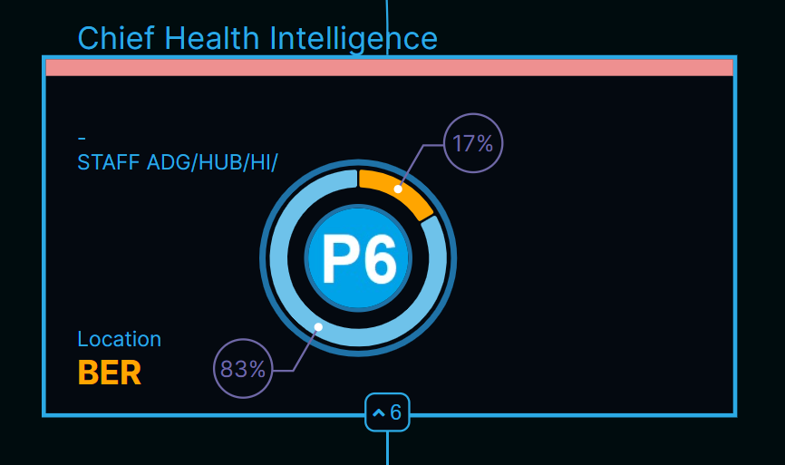
Position title
Non-staff are marked with a grey background
3 Department colors :
Red: ADG office
Green: Engagement
Blue: Systems
% alignement (i.e. if there are some personal comments in excel)
Expected Grade
Expected base station
# of direct reports

